Slide 1


UE19CS204 – WEB TECHNOLOGIES MINI-PROJECT
PROJECT TITLE: EXPENSE TRACKER
Section - C
GAUTHAM ANAND S - PES1UG19CS165
H V SASHI KANTH REDDY - PES1UG19CS176
H V RAVI KANTH REDDY - PES1UG19CS188
FARAAZ KHAN - PES1UG19CS153
GITHUB Link -https://github.com/faraazkhan1112/Web-Tech-mini-project

Slide 2




ABSTRACT
Expense Tracker.
A Full Stack web application built with MERN Stack.
With this application you can keep track of your finances by adding the amount and what it was spent for.
This application uses ExpressJS framework for the backend APIs and ReactJS for front-end views. The Data is stored with NoSQL database using MongoDB/mongoose.

Slide 3
TECHNOLOGIES USED
(Additional modules/libraries used):
=> #Dependencies
npm install express cors mongoose dotenv
npm install -g nodemon.
=> #Bootstrap CSS framework
npm install bootstrap.
=> #Axios library.
npm install axios.
=> #Prod
npm start
Runs the app in the development mode.
Open http://localhost:3000 to view it in the browser.

Slide 4
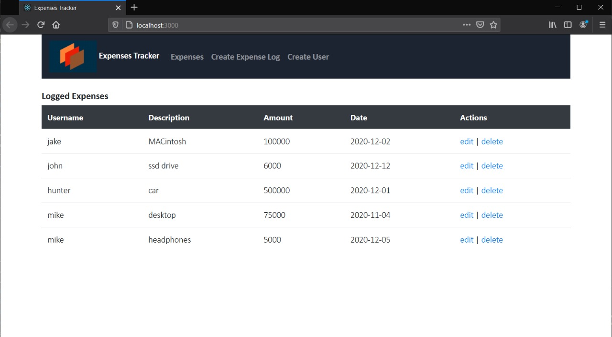
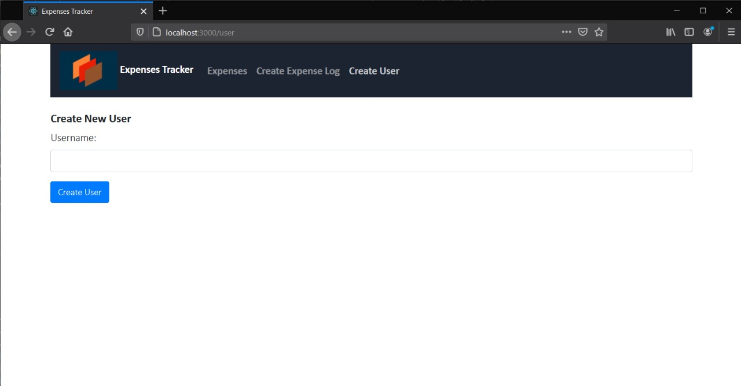
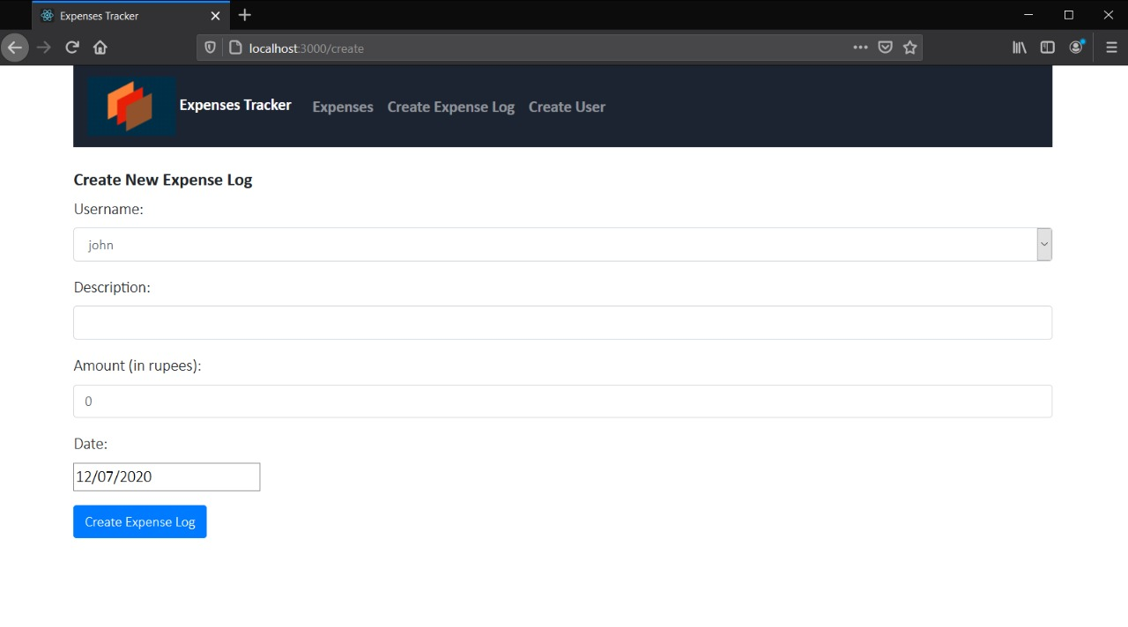
APP SCREENSHOTS

Slide 5
MEMBER CONTRIBUTIONS
(Functionality worked on by each team member).
H.V.SASHI KANTH REDDY => edit-expense-component and create-user-component.
H.V.RAVI KANTH REDDY => Navbar component and server.js.
GAUTHAM ANAND S => Expenses-list component and user-model in routes.
FARAAZ KHAN => expenses model and route, create expense component.

